Slide 1
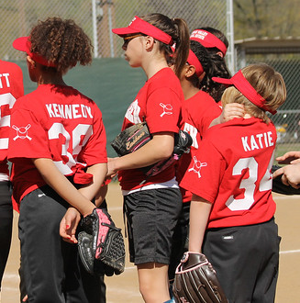



Playing Fair: Title IX &
Gender Equity in K-12 Athletics (Abridged)
Note: This material does not constitute legal advice and is general information!
Consult your general counsel if you need help

Slide 2



Benefits for Girls that Play Sports
Health
  Lower rates of depression
  Lower rates of breast cancer as adults
Academic
  Higher rates of graduation, especially
  among girls of color, at high school
  and college level
Employment
  90% of “C-Suite” women played sports
  growing up
  Female athletes in high school correlated
  with 7% higher wage as adults

Slide 3
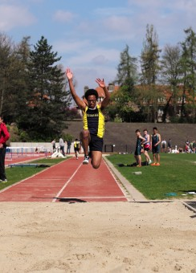
Issue: Gender Inequity in School Sports
ISSUE: LACKING OPPORTUNITY TO PLAY
Today, girls are getting 1 million fewer chances
to play compared to boys across U.S. (NFHS data)
4.5 million+ boys playing in high schools and
just 3.4 million girls, despite girls wanting to playing
far more (assess via surveys of girls, try-out lists + club / rec sports)
  In CA, boys are receiving 100,000+ more high school sports opportunities compared to girls (NFHS + census data)
ISSUE: Persistent (OVERALL) program gender inequities
E.g., softball field inferior to baseball field; girls’ locker / team rooms fewer and worse than boys’ locker / team rooms; schedule inequity

Slide 4

Law – Title IX
Federal law
  Prohibits gender discrimination
Became law in 1972 (49 years old!)
  Equity mandate in place for half a century
  Applies in CA and every state of the U.S.
Applies To:
  K-12 schools (elem., middle, and high schools!) + charters!
  Colleges and universities
  Educational entities accepting federal funds (even just $1)
Students must be treated equitably in academics and athletics, regardless of gender + it’s not just the law, right thing to do!

Slide 5
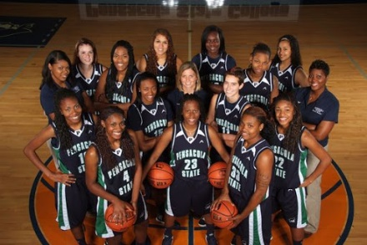
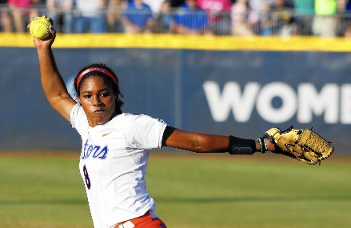

Title IX - Components
Equal Participation Opportunities –
ensuring equity in opportunity to play!
(overall # of roster slots - girls want more!)
Equal Treatment and Benefits –
ensuring equity in the experience of
student athletes – looking at ALL the
girls’ and boys’ teams together on the scales;
how equal are the girls’ experiences, overall?
Anti-Retaliation – complaints of
gender inequity should not lead
to retaliation (backlash barred by law)

Slide 6

Participation – 3 Compliance Prongs
Prong 1: Proportionality (Gold Standard) –
Male to female ratio of athletes is
“substantially proportionate” to the
male to female ratio of student enrollment; OR
Prong 2: History AND Continuing Practice of Expansion –
The school has a history and continuing practice of expanding athletic participation opportunities for the underrepresented sex; OR (note, hard standard to meet; need “steady march forward”!)
Prong 3: Full Accommodation –
The school has fully and effectively accommodated the interests and abilities of the underrepresented sex (e.g., survey data)

Slide 7
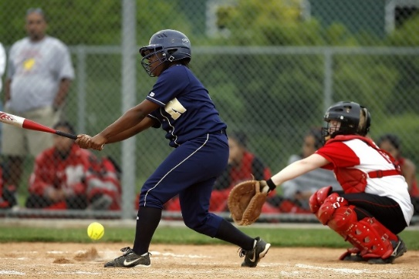
Prong 1- HS Participation Example
2000 students @ high school
1000 male (50% student body)
1000 female (50% student body)
200 athletes in athletic program
120 males athletes (3 sports teams) (60%)
80 female athletes (7 sports teams) (40%) [if proportional, 120]
Participation Gap? Yes – 10% (50%-40% = 10%) Not proportional
How many to add for proportionality? 40 more female students
**Courts: 6.7% and 3.2% gaps are not substantially proportional**
Note: Surveys of girls show what they want to play! Assess, adjust, add!

Slide 8
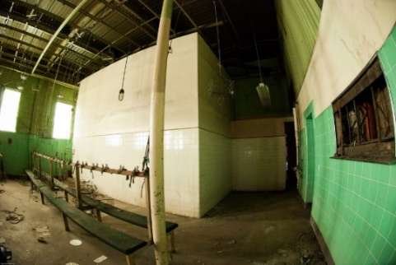
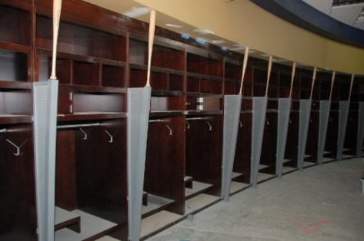
Treatment & Benefits Elements
“Laundry List” re: program of school, assess:
(1) Equipment and Supplies
(2) Scheduling – Practices / Games
(3) Travel
(4) Coaching – Assignment + Compensation
(5) Fundraising Opportunities
(6) Facilities – Locker Rooms, Team
Rooms, Practice + Competitive Spaces
(7) Medical + Training – Services & Facilities
(8) Publicity
(9) Support Services
Note: College - recruiting; housing & dining; scholarships

Slide 9
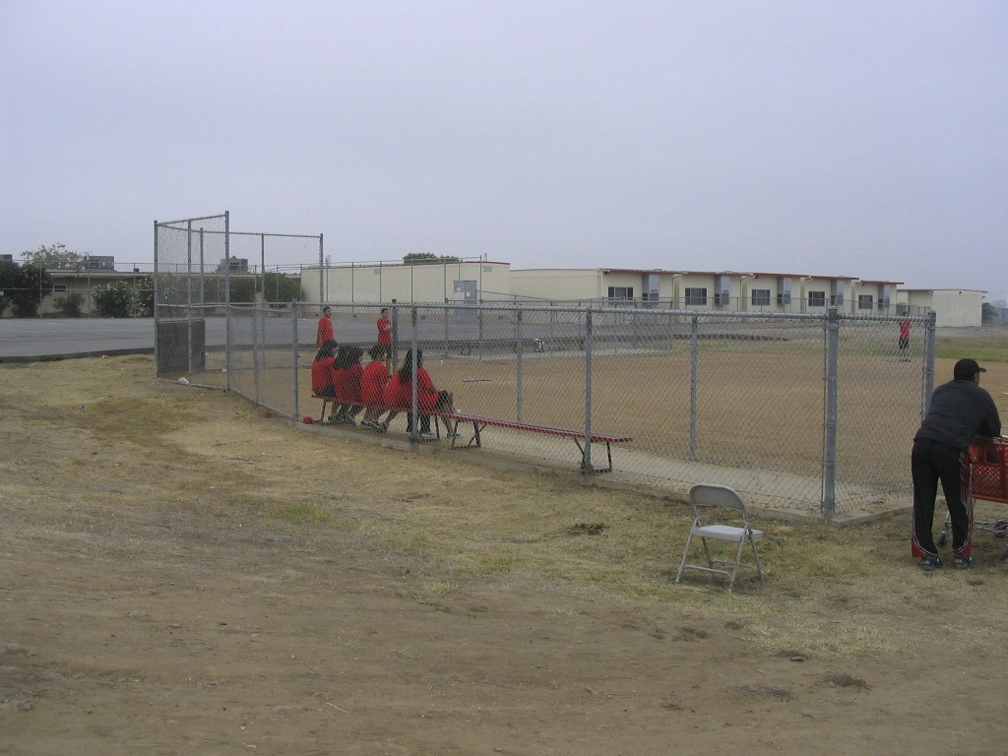
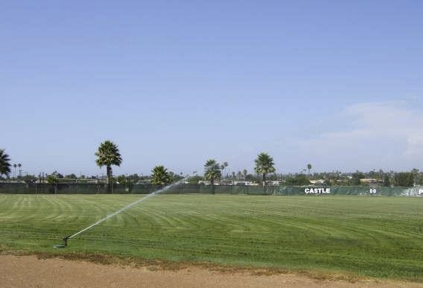
Equal Treatment and Benefits (Typical) Inequity Example
Girls’ Softball Field Boys’ Baseball Field
(shared with P.E.) (locked, exclusive use)
Note: Schools / districts must ensure gender equity across athletic program.

Slide 10

Thank You & Questions / Input
da
Questions? Need training?
Contact Fair Play!
Resources: E.g., OCR;
State Depts. of Ed.;
National Women’s Law Center;
Women’s Sports Foundation;
CA Women’s Law Center;
Fair Play for Girls in Sports; more!
Follow & Access Fair Play Tools www.fairplayforgirlsinsports.org
fairplay@legalaidatwork.org fairplay4girls (FB / Twitter/ IG)

